Slide 1
Unit I Introduction to Big Data
Prof. Kritika Purohit
Assistant Professor
Department of Computer Science & Engineering

Slide 2
Points to be covered-
Data: Definition, types, sources of data, small data v/s big data
Big data: definition, characteristics of data, challenges of big data, 5 V's, Sources of big data,, Traditional v/s big data
What is BDA
Terminology used in Big data environments, Analytical Tools, BD technology- NoSQL, Hadoop
SQL Overview
Hadoop intro : Why Hadoop, RDBMS v/s Hadoop
Google File System and HDFS
Hadoop ecosystem components for data processing and data analysis
Building blocks of Hadoop
Configuring Hadoop cluster architecture in different modes(standalone, Pseudo, distributed)

Slide 3
Data
Data Information
Information Insights
Definition :- The quantities, characters, or symbols on which operations are performed by a computer, which may be stored and transmitted in the form of electrical signals and recorded on magnetic, optical, or mechanical recording media.
In computing data is an information that has been translated into a form that is efficient for movement or processing.
Digital Data is the data that represents other forms of data using specific machine language systems that can be interpreted by various technologies.

Slide 4
Types of Data:-
Structured:- Structured is one of the types of big data and By structured data, we mean data that can be processed, stored, and retrieved in a fixed format. It refers to highly organized information that can be readily and seamlessly stored and accessed from a database by simple search engine algorithms.
Unstructured:- Unstructured data refers to the data that lacks any specific form or structure whatsoever. This makes it very difficult and time-consuming to process and analyze unstructured data.
Semi-structured:- Semi structured is the third type of big data. Semi-structured data pertains to the data containing both the formats mentioned above, that is, structured and unstructured data. To be precise, it refers to the data that although has not been classified under a particular repository (database) yet contains vital information or tags that segregate individual elements within the data.

Slide 5
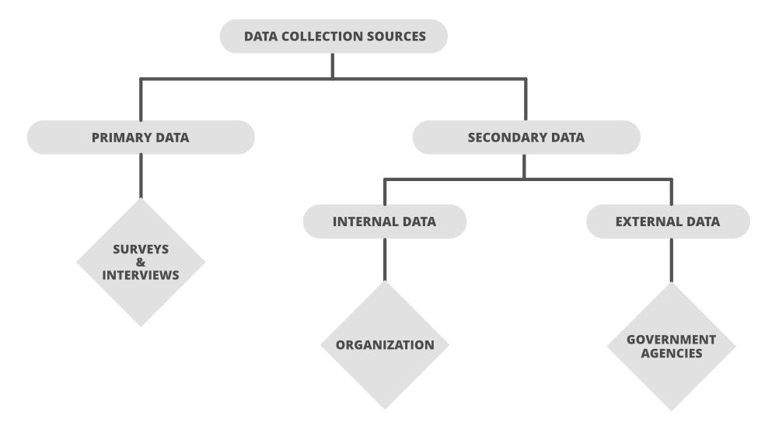
Sources of Data

Slide 6
Small Data vs Big Data
Small Data-
It can be defined as small datasets that are capable of impacting decisions in the present. Anything that is currently ongoing and whose data can be accumulated in an Excel file.
Small data is also useful in decision-making but is not intended to have a large impact on business, rather for a short period of time.
Small data can be described as small datasets that can have an influence on current decisions.
In nutshell, data that is simple enough to be used for human understanding in such a volume and structure that makes it accessible, concise, and workable is known as small data.

Slide 7
Feature | Small Data | Big Data
Technology | Traditional | Modern
Collection | Generally, it is obtained in an organized manner than is inserted into the database | The Big Data collection is done by using pipelines having queues like AWS Kinesis or Google Pub / Sub to balance high-speed data
Volume | Data in the range of tens or hundreds of Gigabytes | Size of Data is more than Terabytes
Analysis Areas | Data marts(Analysts) | Clusters(Data Scientists), Data marts(Analysts)
Quality | Contains less noise as data is less collected in a controlled manner | Usually, the quality of data is not guaranteed
Processing | It requires batch-oriented processing pipelines | It has both batch and stream processing pipelines
Database | SQL | NoSQL
Velocity | A regulated and constant flow of data, data aggregation is slow | Data arrives at extremely high speeds, large volumes of data aggregation in a short time
Structure | Structured data in tabular format with fixed schema(Relational) | Numerous variety of data set including tabular data, text, audio, images, video, logs, JSON etc.(Non-Relational)
Scalability | They are usually vertically scaled | They are mostly based on horizontally scaling architectures, which gives more versatility at a lower cost
Query Language | only Sequel | Python, R, Java, Sequel
Hardware | A single server is sufficient | Requires more than one server
Value | Business Intelligence, analysis and reporting | Complex data mining techniques for pattern finding, recommendation, prediction etc.
Optimization | Data can be optimized manually(human powered) | Requires machine learning techniques for data optimization
Storage | Storage within enterprises, local servers etc. | Usually requires distributed storage systems on cloud or in external file systems
People | Data Analysts, Database Administrators and Data Engineers | Data Scientists, Data Analysts, Database Administrators and Data Engineers
Security | Security practices for Small Data include user privileges, data encryption, hashing, etc. | Securing Big Data systems are much more complicated. Best security practices include data encryption, cluster network isolation, strong access control protocols etc.
Nomenclature | Database, Data Warehouse, Data Mart | Data Lake
Infrastructure | Predictable resource allocation, mostly vertically scalable hardware. | More agile infrastructure with horizontally scalable hardware

Slide 8
Big Data
‘Big Data' is also a data but with a huge size. 'Big Data' is a term used to describe collection of data that is huge in size and yet growing exponentially with time. Data which are very large in size is called Big Data.
Definition:- Big data is larger, more complex data sets, especially from new data sources. These data sets are so voluminous that traditional data processing software just can’t manage them. But these massive volumes of data can be used to address business problems you wouldn’t have been able to tackle before.
It refers to a massive amount of data that keeps on growing exponentially with time. It is so voluminous that it cannot be processed or analyzed using conventional data processing techniques.
It includes data mining, data storage, data analysis, data sharing, and data visualization. The term is an all-comprehensive one including data, data frameworks, along with the tools and techniques used to process and analyze the data.

Slide 9
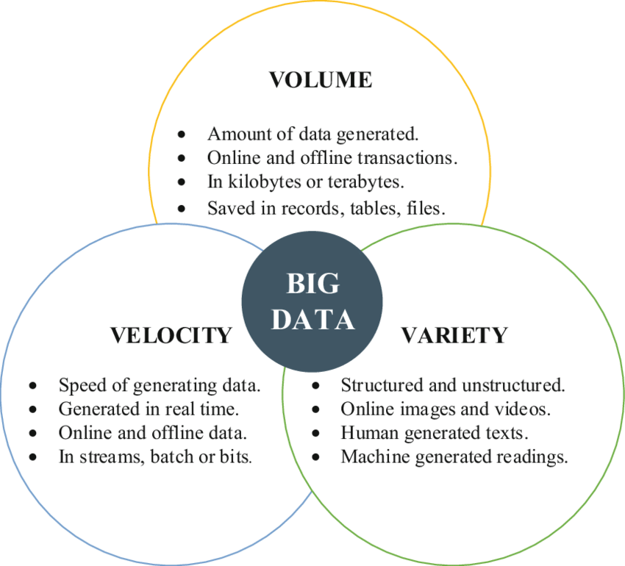
Characteristics of Big Data-

Slide 10
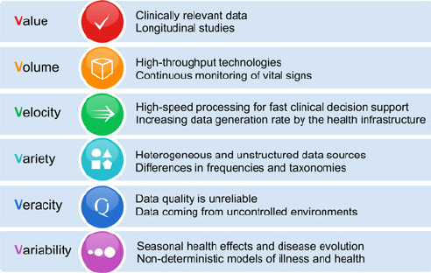

Slide 11
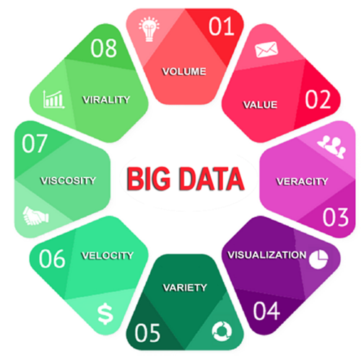

Slide 12
Advantages of Big Data
Predictive Analysis
Enhanced Customer Experience
Accurate or actionable insights
Increased revenue
Higher sales and Customer satisfaction

Slide 13
Disadvantages of Big Data-
Lack of proper understanding
Difficult to choose from various big data technologies
High cost involved
Complex data management
Lack of Data Professionals
Data Security
Data Integration from various sources

Slide 14
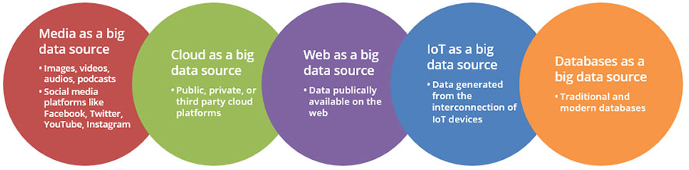
Sources of Big Data
Data, as we know, is massive and exists in various forms. If it is not classified or sourced well, it can end up wasting precious time and resources. In order to achieve success with big data, it is important that companies have the know-how to sift between the various data sources available and accordingly classify its usability and relevance.

Slide 15
Traditional v/s big data
S.No. | TRADITIONAL DATA | BIG DATA
01. | Traditional data is generated in enterprise level. | Big data is generated in outside and enterprise level.
02. | Its volume ranges from Gigabytes to Terabytes. | Its volume ranges from Petabytes to Zettabytes or Exabyte.
03. | Traditional database system deals with structured data. | Big data system deals with structured, semi structured and unstructured data.
04. | Traditional data is generated per hour or per day or more. | But big data is generated more frequently mainly per seconds.
05. | Traditional data source is centralized, and it is managed in centralized form. | Big data source is distributed, and it is managed in distributed form.
06. | Data integration is very easy. | Data integration is very difficult.
07. | Normal system configuration is capable to process traditional data. | High system configuration is required to process big data.
08. | Its data sources includes ERP transaction data, CRM transaction data, financial data, organizational data, web transaction data etc. | Its data sources includes social media, device data, sensor data, video, images, audio etc.
09. | Traditional data base tools are required to perform any data base operation. | Special kind of data base tools are required to perform any data base operation.
10. | Normal functions can manipulate data. | Special kind of functions can manipulate data.
11. | Its data model is strict schema based and it is static. | Its data model is flat schema based and it is dynamic.
12.. | Traditional data is stable and inter relationship. | Big data is not stable and unknown relationship.
13. | Traditional data is in manageable volume. | Big data is in huge volume which becomes unmanageable.
14. | It is easy to manage and manipulate the data. | It is difficult to manage and manipulate the data.

Slide 16
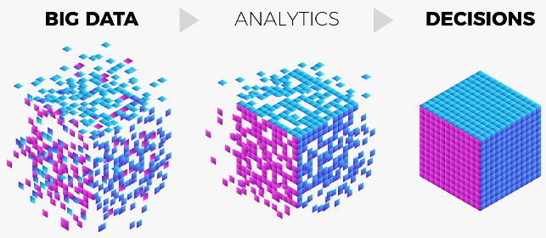
What is BDA?
Big data analytics is the use of advanced analytic techniques against very large, diverse big data sets that include structured, semi-structured and unstructured data, from different sources, and in different sizes from terabytes to zettabytes.

Slide 17
The Big Data Analytics Life cycle is divided into nine phases, named as :
Business Case/Problem Definition
Data Identification
Data Acquisition and filtration
Data Extraction
Data Munging(Validation and Cleaning)
Data Aggregation & Representation(Storage)
Exploratory Data Analysis
Data Visualization(Preparation for Modeling and Assessment)
Utilization of analysis results.

Slide 18
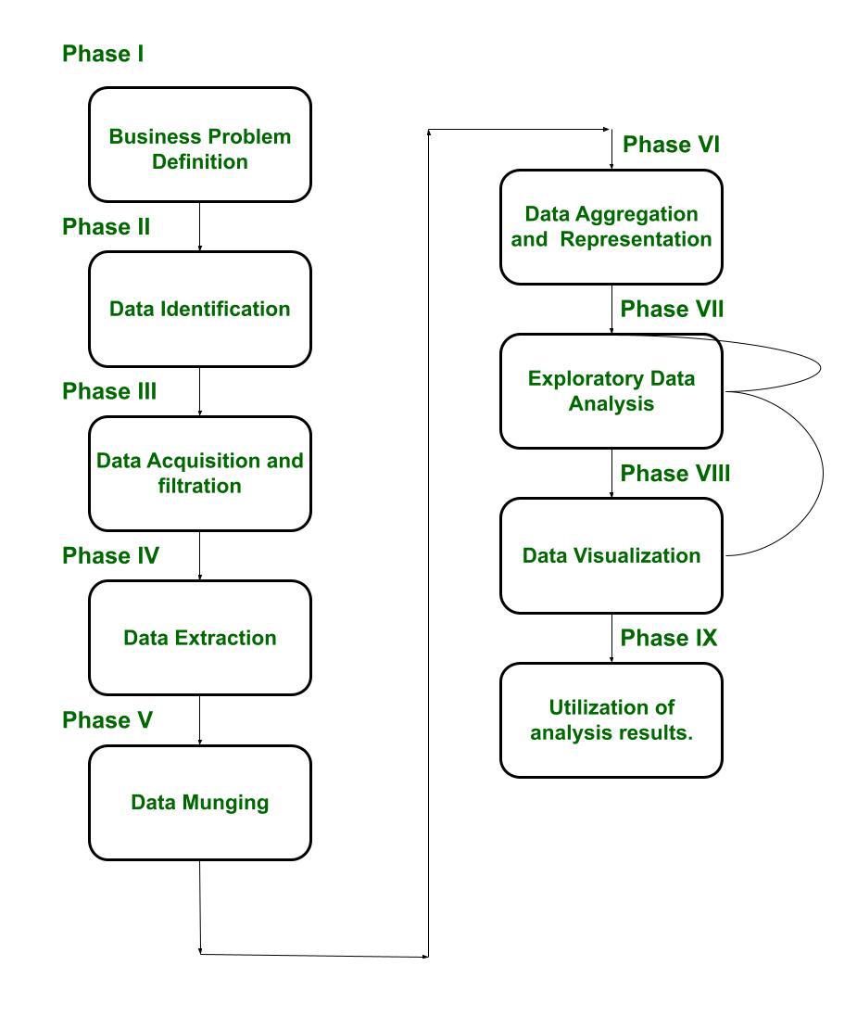

Slide 19
Benefits of Big Data Analytics
Faster, better decision making- Businesses can access a large volume of data and analyze a large variety sources of data to gain new insights and act. Get started small and scale to handle data from historical records and in real-time.
Cost reduction and operational efficiency- Flexible data processing and storage tools can help organizations save costs in storing and analyzing large amounts of data. Discover patterns and insights that help you identify do business more efficiently.
Improved data-driven go to market- Analyzing data from sensors, devices, video, logs, transactional applications, web and social media empowers an organization to be data-driven. Gauge customer needs and potential risks and create new products and services.

Slide 20
Application areas of BDA
Healthcare
Manufacturing
Media and Entertainment
Internet of Things
Cyber security & Intelligence
Crime Prediction and Prevention
Pharmaceutical Drug Evaluation
Scientific Research
Weather Forecasting
Tax Compliance
Traffic Optimization

Slide 21

Application Area of BDA
Health Care-

Slide 22
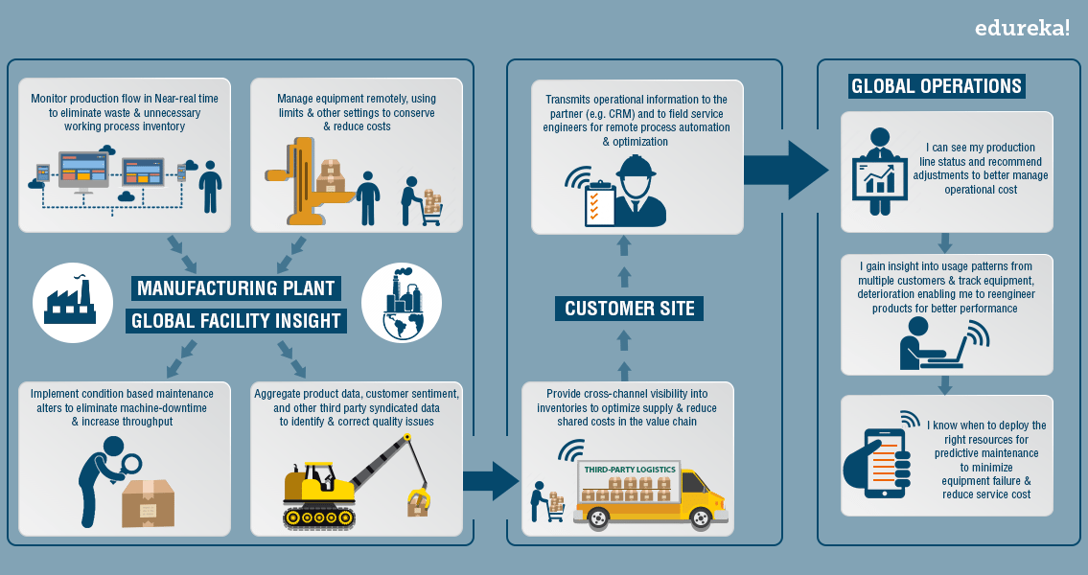
Manufacturing

Slide 23
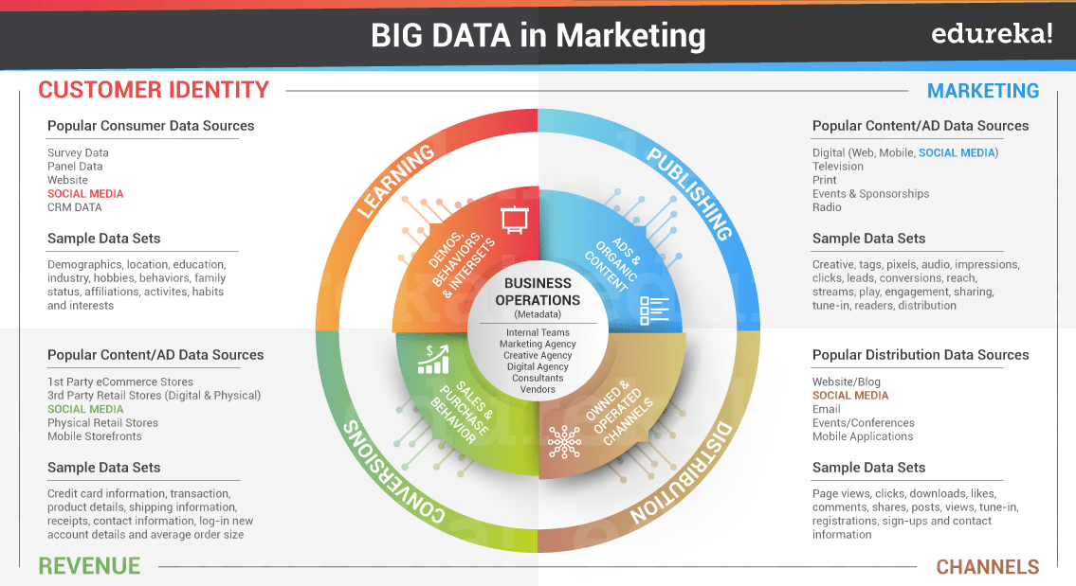
Media & Entertainment

Slide 24
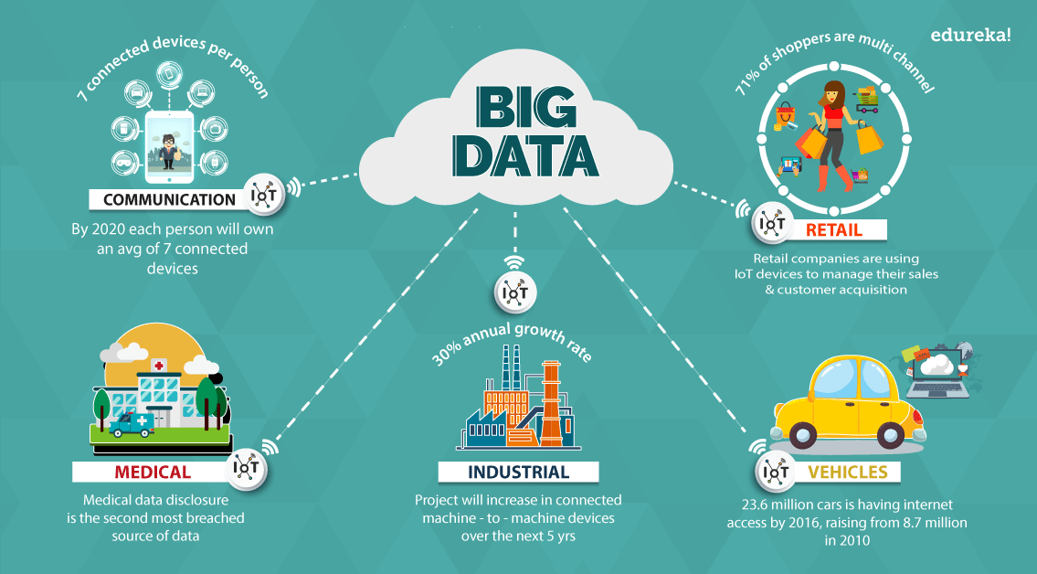

Slide 25
Terminology used in Big data environments
Batch processing: Batch processing is a computing strategy that involves processing data in large sets. This is typically ideal for non-time sensitive work that operates on very large sets of data.
Cluster computing: Clustered computing is the practice of pooling the resources of multiple machines and managing their collective capabilities to complete tasks.
Data lake: Data lake is a term for a large repository of collected data in a relatively raw state. This is frequently used to refer to the data collected in a big data system which might be unstructured and frequently changing
Data mining: Data mining is a broad term for the practice of trying to find patterns in large sets of data. It is the process of trying to refine a mass of data into a more understandable and cohesive set of information.

Slide 26
Data warehouse: Data warehouses are large, ordered repositories of data that can be used for analysis and reporting. In contrast to a data lake, a data warehouse is composed of data that has been cleaned, integrated with other sources, and is generally well-ordered.
ETL: ETL stands for extract, transform, and load. It refers to the process of taking raw data and preparing it for the system’s use.
Hadoop: Hadoop is an Apache project that was the early open-source success in big data. It consists of a distributed filesystem called HDFS, with a cluster management and resource scheduler on top called YARN (Yet Another Resource Negotiator).
In-memory computing: In-memory computing is a strategy that involves moving the working datasets entirely within a cluster’s collective memory. Intermediate calculations are not written to disk and are instead held in memory.
Machine learning: Machine learning is the study and practice of designing systems that can learn, adjust, and improve based on the data fed to them.

Slide 27
Map reduce (big data algorithm): Map reduce (the big data algorithm, not Hadoop’s MapReduce computation engine) is an algorithm for scheduling work on a computing cluster. The process involves splitting the problem set up (mapping it to different nodes) and computing over them to produce intermediate results, shuffling the results to align like sets, and then reducing the results by outputting a single value for each set.
NoSQL: NoSQL is a broad term referring to databases designed outside of the traditional relational model. NoSQL databases have different trade-offs compared to relational databases but are often well-suited for big data systems due to their flexibility and frequent distributed-first architecture.
Stream processing: Stream processing is the practice of computing over individual data items as they move through a system. This allows for real-time analysis of the data being fed to the system and is useful for time-sensitive operations using high velocity metrics.

Slide 28
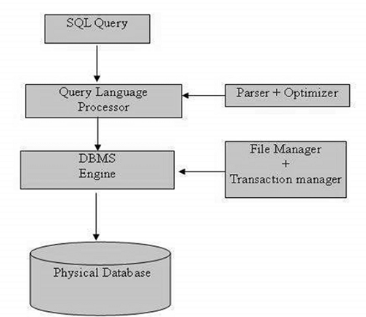
SQL Overview
SQL is Structured Query Language, which is a computer language for storing, manipulating and retrieving data stored in a relational database.
SQL is the standard language for Relational Database System. All the Relational Database Management Systems (RDMS) like MySQL, MS Access, Oracle, Sybase, Informix, Postgres and SQL Server use SQL.
SQL Architecture-

Slide 29
The standard SQL commands to interact with relational databases are CREATE, SELECT, INSERT, UPDATE, DELETE and DROP. These commands can be classified into the following groups based on their nature −
Data Definition Language (CREATE, ALTER, DROP)
Data Manipulation Language (SELECT, INSERT, UPDATE, DELETE)
Data Control Language (GRANT, REVOKE)

Slide 30
Hadoop: Introduction
Hadoop is an open-source framework. It is provided by Apache to process and analyze very huge volume of data. It is written in Java and currently used by Google, Facebook, LinkedIn, Yahoo, Twitter etc.
In other words, Hadoop is an open-source software framework for storing data and running applications on clusters of commodity hardware. It provides massive storage for any kind of data, enormous processing power and the ability to handle virtually limitless concurrent tasks or jobs.

Slide 31
Why is Hadoop important?
Ability to store and process huge amounts of any kind of data, quickly.
Computing power.
Fault tolerance.
Flexibility.
Low cost.
Scalability.

Slide 32
Modules of Hadoop
HDFS: Hadoop Distributed File System. Google published its paper GFS and based on that HDFS was developed. It states that the files will be broken into blocks and stored in nodes over the distributed architecture.
Yarn: Yet another Resource Negotiator is used for job scheduling and manage the cluster.
Map Reduce: This is a framework which helps Java programs to do the parallel computation on data using key value pair. The Map task takes input data and converts it into a data set which can be computed in Key value pair. The output of Map task is consumed by reduce task and then the out of reducer gives the desired result.
Hadoop Common: These Java libraries are used to start Hadoop and are used by other Hadoop modules.

Slide 33

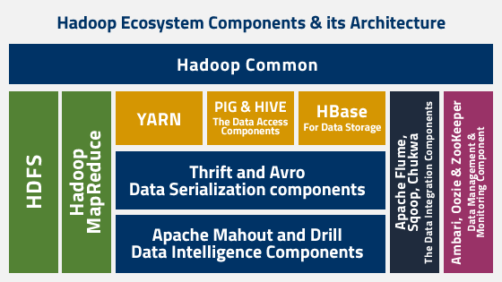

Slide 34
Hadoop Ecosystem is a platform or a suite which provides various services to solve the big data problems. It includes Apache projects and various commercial tools and solutions. There are four major elements of Hadoop i.e. HDFS, MapReduce, YARN, and Hadoop Common. Most of the tools or solutions are used to supplement or support these major elements. All these tools work collectively to provide services such as absorption, analysis, storage and maintenance of data etc.

Slide 35
Following are the components that collectively form a Hadoop ecosystem:
HDFS: Hadoop Distributed File System
YARN: Yet Another Resource Negotiator
MapReduce: Programming based Data Processing
Spark: In-Memory data processing
PIG, HIVE: Query based processing of data services
HBase: NoSQL Database
Mahout, Spark MLLib: Machine Learning algorithm libraries
Solar, Lucene: Searching and Indexing
Zookeeper: Managing cluster
Oozie: Job Scheduling

Slide 36
HDFS: HDFS is the primary or major component of Hadoop ecosystem and is responsible for storing large data sets of structured or unstructured data across various nodes and thereby maintaining the metadata in the form of log files. HDFS consists of two core components i.e.
Name node
Data Node
Name Node is the prime node which contains metadata (data about data) requiring comparatively fewer resources than the data nodes that stores the actual data. These data nodes are commodity hardware in the distributed environment. Undoubtedly, making Hadoop cost effective. HDFS maintains all the coordination between the clusters and hardware, thus working at the heart of the system.

Slide 37
YARN: Yet Another Resource Negotiator, as the name implies, YARN is the one who helps to manage the resources across the clusters. In short, it performs scheduling and resource allocation for the Hadoop System. Consists of three major components i.e.
Resource Manager
Nodes Manager
Application Manager
Resource manager has the privilege of allocating resources for the applications in a system whereas Node managers work on the allocation of resources such as CPU, memory, bandwidth per machine and later on acknowledges the resource manager. Application manager works as an interface between the resource manager and node manager and performs negotiations as per the requirement of the two.

Slide 38
MapReduce: By making the use of distributed and parallel algorithms, MapReduce makes it possible to carry over the processing logic and helps to write applications which transform big data sets into a manageable one. MapReduce makes the use of two functions i.e. Map() and Reduce() whose task is:
Map() performs sorting and filtering of data and thereby organizing them in the form of group. Map generates a key-value pair based result which is later on processed by the Reduce() method.
Reduce(), as the name suggests does the summarization by aggregating the mapped data. In simple, Reduce() takes the output generated by Map() as input and combines those tuples into smaller set of tuples.

Slide 39
PIG: Pig was basically developed by Yahoo which works on a pig Latin language, which is Query based language similar to SQL.
It is a platform for structuring the data flow, processing and analyzing huge data sets.
Pig does the work of executing commands and in the background, all the activities of MapReduce are taken care of. After the processing, pig stores the result in HDFS.
Pig Latin language is specially designed for this framework which runs on Pig Runtime. Just the way Java runs on the JVM.
Pig helps to achieve ease of programming and optimization and hence is a major segment of the Hadoop Ecosystem.

Slide 40
HIVE: With the help of SQL methodology and interface, HIVE performs reading and writing of large data sets. However, its query language is called as HQL (Hive Query Language).
It is highly scalable as it allows real-time processing and batch processing both. Also, all the SQL datatypes are supported by Hive thus, making the query processing easier.
Similar to the Query Processing frameworks, HIVE too comes with two components: JDBC Drivers and HIVE Command Line.
JDBC, along with ODBC drivers work on establishing the data storage permissions and connection whereas HIVE Command line helps in the processing of queries.

Slide 41
Mahout: Mahout, allows Machine Learnability to a system or application. Machine Learning, as the name suggests helps the system to develop itself based on some patterns, user/environmental interaction or on the basis of algorithms.
It provides various libraries or functionalities such as collaborative filtering, clustering, and classification which are nothing but concepts of Machine learning. It allows invoking algorithms as per our need with the help of its own libraries.

Slide 42
Apache Spark:
It’s a platform that handles all the process consumptive tasks like batch processing, interactive or iterative real-time processing, graph conversions, and visualization, etc.
It consumes in memory resources hence, thus being faster than the prior in terms of optimization.
Spark is best suited for real-time data whereas Hadoop is best suited for structured data or batch processing, hence both are used in most of the companies interchangeably.

Slide 43
Apache HBase:
It’s a NoSQL database which supports all kinds of data and thus capable of handling anything of Hadoop Database. It provides capabilities of Google’s BigTable, thus able to work on Big Data sets effectively.
At times where we need to search or retrieve the occurrences of something small in a huge database, the request must be processed within a short quick span of time. At such times, HBase comes handy as it gives us a tolerant way of storing limited data

Slide 44
Other Components:
Solr, Lucene: These are the two services that perform the task of searching and indexing with the help of some java libraries, especially Lucene is based on Java which allows spell check mechanism, as well. However, Lucene is driven by Solr.
Zookeeper: There was a huge issue of management of coordination and synchronization among the resources or the components of Hadoop which resulted in inconsistency, often. Zookeeper overcame all the problems by performing synchronization, inter-component based communication, grouping, and maintenance.
Oozie: Oozie simply performs the task of a scheduler, thus scheduling jobs and binding them together as a single unit. There is two kinds of jobs .i.e Oozie workflow and Oozie coordinator jobs. Oozie workflow is the jobs that need to be executed in a sequentially ordered manner whereas Oozie Coordinator jobs are those that are triggered when some data or external stimulus is given to it.

Slide 45
Google File System
The Google File System, a scalable distributed file system for large distributed data- intensive applications. It provides fault tolerance while running on inexpensive commodity hardware, and it delivers high aggregate performance to many clients.
GFS provides a familiar file system interface, though it does not implement a standard API such as POSIX. Files are organized hierarchically in directories and identified by path-names. We support the usual operations to create, delete, open, close, read, and write files.
GFS has snapshot and records append operations. Snapshot creates a copy of a file, or a directory treat low cost. Record append allows multiple clients to append data to the same file concurrently while guaranteeing the atomicity of each individual client's append.

Slide 46
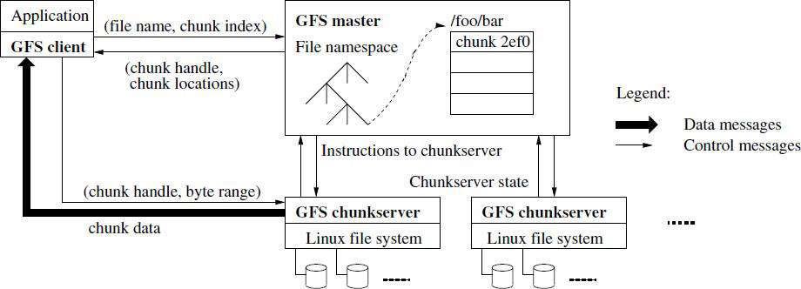
GFS Architecture- A GFS cluster consists of a single master and multiple chunk servers and is accessed by multiple clients, as shown in Figure.

Slide 47
Each of these is typically a commodity Linux machine running a user-level server process. It is easy to run both a chunkserver and a client on the same machine, if machine resources permit, and the lower reliability caused by running possibly flaky application code is acceptable.
Files are divided into fixed-size chunks. Each chunk is identified by an immutable and globally unique 64-bit chunk handle assigned by the master at the time of chunk creation.
Chunkservers store chunks on local disks as Linux files and read or write chunk data specified by a chunk handle and byte range. For reliability, each chunk is replicated on multiple chunkservers. By default, we store three replicas, though users can designate different replication levels for different regions of the file namespace. The master maintains all file system metadata. This includes the namespace, access control information, the mapping from files to chunks, and the current locations of chunks.

Slide 48
It also controls system-wide activities such as chunk lease management, garbage collection of orphaned chunks, and chunk migration between chunkservers. The master periodically communicates with each chunkserver in Heartbeat messages to give it instructions and collect its state.
GFS client code linked into each application implements the file system API and communicates with the master and chunkservers to read or write data on behalf of the application. Clients interact with the master for metadata operations, but all data-bearing communication goes directly to the chunkservers. We do not provide the POSIX API and therefore need not hook into the Linux vnode layer.

Slide 49
Single Master: Having a single master vastly simplifies our design and enables the master to make sophisticated chunk placement Application and replication decisions using global knowledge. However, we must minimize its involvement in reads and writes so that it does not become a bottleneck. Clients never read and write file data through the master. Instead, a client asks the master which chunkservers it should contact.
Chunk Size: Chunk size is one of the key design parameters. We have chosen 64 MB, which is much larger than typical file system block sizes. Each chunk replica is stored as a plain Linux file on a chunkserver and is extended only as needed. Lazy space allocation avoids wasting space due to internal fragmentation, perhaps the greatest objection against such a large chunk size. A large chunk size offers several important advantages.

Slide 50
Metadata- The master stores three major types of metadata: the file and chunk namespaces, the mapping from files to chunks, and the locations of each chunk‟s replicas. All metadata is kept in the master’s memory.
In-Memory Data Structures- Since metadata is stored in memory, master operations are fast. Furthermore, it is easy and efficient for the master to periodically scan through its entire state in the background. This periodic scanning is used to implement chunk garbage collection, re-replication in the presence of chunkserver failures, and chunk migration to balance load and disk space usage across chunkservers.

Slide 51
Advantages and disadvantages of large sized chunks in Google File System
Advantages-
It reduces clients‟ need to interact with the master because reads and writes on the same chunk require only one initial request to the master for chunk location information.
Since on a large chunk, a client is more likely to perform many operations on a given chunk, it can reduce network overhead by keeping a persistent TCP connection to the chunk server over an extended period of time.
It reduces the size of the metadata stored on the master. This allows us to keep the metadata in memory, which in turn brings other advantages.

Slide 52
Disadvantages-
Lazy space allocation avoids wasting space due to internal fragmentation.
Even with lazy space allocation, a small file consists of a small number of chunks, perhaps just one. The chunk servers storing those chunks may become hot spots if many clients are accessing the same file. In practice, hot spots have not been a major issue because the applications mostly read large multi-chunk files sequentially. To mitigate it, replication and allowance to read from other clients can be done.

Slide 53
Hadoop is made up of 2 parts:
HDFS – Hadoop Distributed File System
MapReduce – The programming model that is used to work on the data present in HDFS.
Hadoop Distributed File System (HDFS) Building blocks of Hadoop :
Namenode
Datanode
Secondary Name node
JobTracker
TaskTracker

Slide 54
The Hadoop Distributed File System (HDFS) is a distributed file system for Hadoop. It contains a master/slave architecture. This architecture consist of a single NameNode performs the role of master, and multiple DataNodes performs the role of a slave.
Namenode- It is a single master server exist in the HDFS cluster. As it is a single node, it may become the reason of single point failure. It manages the file system namespace by executing an operation like the opening, renaming and closing the files. It simplifies the architecture of the system.
Datanode- The HDFS cluster contains multiple DataNodes. Each DataNode contains multiple data blocks. These data blocks are used to store data. It is the responsibility of DataNode to read and write requests from the file system's clients. It performs block creation, deletion, and replication upon instruction from the NameNode.

Slide 55
Secondary NameNode- Secondary NameNode is one which constantly reads all the file systems and metadata from the RAM of the NameNode and writes it into the hard disk or the file system.
Job Tracker- JobTracker is a master which creates and runs the job. JobTracker which can run on the NameNode allocates the job to TaskTrackers. It is tracking resource availability and task life cycle management, tracking its progress, fault tolerance etc.
Task Tracker- TaskTracker run the tasks and report the status of task to JobTracker. TaskTracker run on DataNodes. It has function of following the orders of the job tracker and updating the job tracker with its progress status periodically.

Slide 56
A Hadoop cluster can comprise of a single node (single node cluster) or thousands of nodes. Once Hadoop is installed, we can try the following few basic commands to work with HDFS:
hadoop fs -ls
hadoop fs -put <path_of_local> <path_in_hdfs>
hadoop fs -get <path_in_hdfs> <path_of_local>
hadoop fs -cat <path_of_file_in_hdfs>
hadoop fs -rmr <path_in_hdfs>

Slide 57
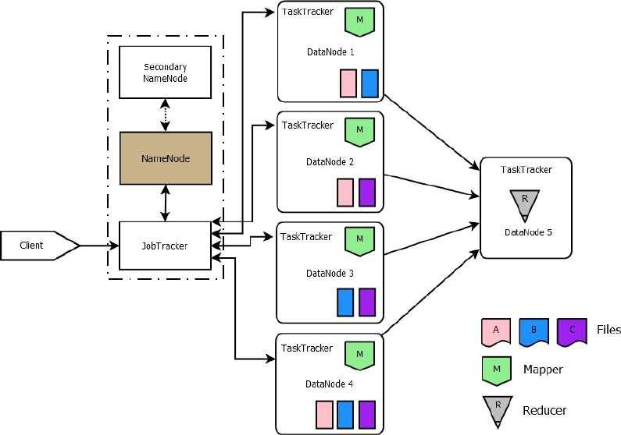
6 Node Hadoop Cluster

Slide 58
Configuration of Hadoop Cluster
Apache Hadoop is an open-source framework that allows distributed processing of large sets of data set across different clusters using simple programming. Hadoop can scale up to thousands of computers from a single server. Thus, in these conditions installation of Hadoop becomes most critical. We can install Hadoop in three different modes:
Standalone mode - Single Node Cluster
Pseudo distributed mode - Single Node Cluster
Distributed mode. - Multi Node Cluster
Purpose for Different Installation Modes- When Apache Hadoop is used in a production environment, multiple server nodes are used for distributed computing. But for understanding the basics and playing around with Hadoop, single node installation is sufficient. There is another mode known as 'pseudo distributed' mode. This mode is used to simulate the multi node environment on a single server.

Slide 59
Standalone Mode Installation - Now, let us check the standalone mode installation process by following the steps mentioned below.
Install Java- Java (JDK Version 1.6.x) either from Sun/Oracle or Open Java is required.
Step 1 - If you are not able to switch to OpenJDK instead of using proprietary Sun JDK/JRE, install sun-java6 from Canonical Partner Repository by using the following command.
Add the canonical partner to the apt repositories using -
$ sudo add-apt-repository "deb http://archive.canonical.com/lucid partner"
Step 2 - Update the source list.
$ sudo apt-get update
Step 3 - Install JDK version 1.6.x from Sun/Oracle.
$ sudo apt-get install sun-java6-jdk

Slide 60
Step 4 - Once JDK installation is over make sure that it is correctly setup using - version
1.6.x from Sun/Oracle.
user@ubuntu:~# java -version java version "1.6.0_45"
Java(TM) SE Runtime Environment (build 1.6.0_45-b02)
Java HotSpot(TM) Client VM (build 16.4-b01, mixed mode, sharing)
Add Hadoop User
Step 5 - Add a dedicated Hadoop unix user into you system as under to isolate this installation from other software -
$ sudo adduser hadoop_admin

Slide 61
Download the Hadoop binary and install
Step 6 - Download Apache Hadoop from the apache web site. Hadoop comes in the form of tar-gx format. Copy this binary into the /usr/local/installables folder. The folder - installables should be created first under /usr/local before this step. Now run the following commands as sudo
$ cd /usr/local/installables
$ sudo tar xzf hadoop-0.20.2.tar.gz
$ sudo chown -R hadoop_admin /usr/local/hadoop-0.20.2
Define env variable - JAVA_HOME
Step 7 - Open the Hadoop configuration file (hadoop-env.sh) in the location -
/usr/local/installables/hadoop-0.20.2/conf/hadoop-env.sh and define the JAVA_HOME as under –
export JAVA_HOME=path/where/jdk/is/installed (e.g. /usr/bin/java)

Slide 62
Installation in Single mode
Step 8 - Now go to the HADOOP_HOME directory (location where HADOOP is extracted) and run the following command –
$ bin/hadoop

Slide 63
The following output will be displayed –
Usage: hadoop [--config confdir] COMMAND
Some of the COMMAND options are mentioned below. There are other options available and can be checked using the command mentioned above.
namenode -format format the DFS filesystem
secondarynamenode run the DFS secondary namenode namenode run the DFS namenode
datanode run a DFS datanode dfsadmin run a DFS admin client
mradmin run a Map-Reduce admin client fsck run a DFS filesystem checking utility
The above output indicates that Standalone installation is completed successfully. Now you can run the sample examples of your choice by calling –
$ bin/hadoop jar hadoop-*-examples.jar <NAME> <PARAMS>

Slide 64
Pseudo Distributed Mode Installation - This is a simulated multi node environment based on a single node server.
The first step required is to configure the SSH in order to access and manage the different nodes. It is mandatory to have the SSH access to the different nodes. Once the SSH is configured, enabled and is accessible we should start configuring the Hadoop. The following configuration files need to be modified:
conf/core-site.xml
conf/hdfs-site.xml
conf/mapred.xml

Slide 65
Open the all the configuration files in vi editor and update the configuration.
Configure core-site.xml file:
$ vi conf/core-site.xml
<configuration>
<property>
<name>fs.default.name</name>
<value>hdfs://localhost:9000</value>
</property>
<property>
<name>hadoop.tmp.dir</name>
<value>/tmp/hadoop-${user.name}</value>
</property>
</configuration>

Slide 66
Configure hdfs-site.xml file:
$ vi conf/hdfs-site.xml
<configuration>
<property>
<name>dfs.replication</name>
<value>1</value>
</property>
</configuration>

Slide 67
Configure mapred.xml file:
$ vi conf/mapred.xml
<configuration>
<property>
<name>mapred.job.tracker</name>
<value>localhost:9001</value>
</property>
</configuration>
Once these changes are done, we need to format the name node by using the following command. The command prompt will show all the messages one after another and finally success message.
$ bin/hadoop namenode –format

Slide 68
Our setup is done for pseudo distributed node. Let's now start the single node cluster by using the following command. It will again show some set of messages on the command prompt and start the server process.
$ /bin/start-all.sh
Now we should check the status of Hadoop process by executing the jps command as shown below. It will show all the running processes.
$ jps
14799 NameNode
14977 SecondaryNameNode
15183 DataNode
15596 JobTracker
15897 TaskTracker

Slide 69
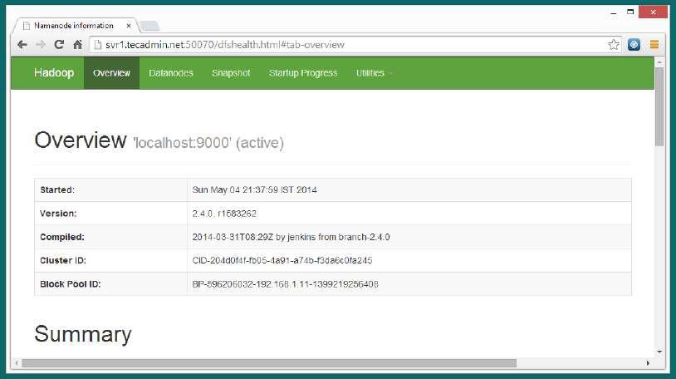
Accessing Hadoop on Browser: The default port number to access Hadoop is 50070. Use the following url to get Hadoop services on browser. http://localhost:50070/

Slide 70
Stopping the Single node Cluster: We can stop the single node cluster by using the following command. The command prompt will display all the stopping processes.
$ bin/stop-all.sh
stopping jobtracker
localhost: stopping tasktracker
stopping namenode
localhost: stopping datanode
localhost: stopping secondarynamenode

Slide 71
Fully Distributed Mode Installation
Compatibility Requirements-
Installation Items
Note: Both Items are required to be installed on Namenode and Datanode machines
Category | Supported
Languages | Java, Python, Perl, Ruby etc.
Operating System | Linux (Server Deployment) Mostly preferred, Windows (Development only), Solaris.
Hardware | 32 bit Linux ( 64 bit for large deployment )
Item | Version
jdk-6u25-linux-i586.bin | Java 1.6 or higher
hadoop-0.20.2-cdh3u0.tar.gz | Hadoop 0.20.2

Slide 72
Installation Requirements-
Requirement | Reason
Operating system – Linux recommended for server deployment (Production env.)
Language – Java 1.6 or higher
Ram – at least 3 GB/node
Hard disk – at least 1 TB | For namenode machine.
Should have root credentials | For changing some system files you need admin permissions.
High Level Steps-
1 | Binding IP address with the host name under /etc/hosts
2 | Setting passwordless SSH
3 | Installing Java
4 | Installing Hadoop
5 | Setting JAVA HOME and HADOOP HOME variables
6 | Updating .bash_profile file for Hadoop
7 | Creating required folders for namenode and datanode
8 | Configuring the .xml files
9 | Setting the masters and slaves in all the machines
10 | Formatting the namenode
11 | Starting the Dfs services and mapred services
12 | Stopping all services

Slide 73
Before we start the distributed mode installation, we must ensure that we have the pseudo distributed setup done and we have at least two machines, one acting as master and the other acting as a slave.
Now we run the following commands in sequence.
$ bin/stop-all.sh- Make sure none of the nodes are running
Binding IP address with the host names
Before starting the installation of hadoop, first you need to bind the IP address of the machines along with their host names under /etc/hosts file.
First check the hostname of your machine by using following command :
$ hostname
Open /etc/hosts file for binding IP with the hostname
$ vi /etc/hosts
Provide ip & hostname of the all the machines in the cluster e.g:
10.11.22.33 hostname1 10.11.22.34 hostname2

Slide 74
Setting Passwordless SSh login
SSH is used to login from one system to another without requiring passwords. This will be required when you run a cluster, it will not prompt you for the password again and again.
First log in on Host1 (hostname of namenode machine) as hadoop user and generate a pair of authentication keys. Command is:
hadoop@Host1$ ssh-keygen –t rsa
Note: Give the hostname which you got in step 5.3.1. Do not enter any passphrase if asked.
Now use ssh to create a directory ~/.ssh as user hadoop on Host2 (Hostname other than namenode machine). Now we open the two files - conf/master and conf/slaves. The conf/master defines the name nodes of our multi node cluster. The conf/slaves file lists the hosts where the Hadoop Slave will be running.

Slide 75
Edit the conf/core-site.xml file to have the following entries -
<property>
<name>fs.default.name</name>
<value>hdfs://master:54310</value>
</property>
Edit the conf/mapred-site.xml file to have the following entries -
<property>
<name>mapred.job.tracker</name>
<value>hdfs://master:54311</value>
</property>
Edit the conf/hdfs-site.xml file to have the following entries -
<property>
<name>dfs.replication</name>
<value>2</value>
</property>

Slide 76
Edit the conf/mapred-site.xml file to have the following entries -
<property>
<name>mapred.local.dir</name>
<value>${hadoop-tmp}/mapred/local</value>
</property>
<property>
<name>mapred.map.tasks</name>
<value>50</value>
</property>
<property>
<name>mapred.reduce.tasks</name>
<value>5</value>
</property>
Now start the master by using the followingcommand. bin/start-dfs.sh

Slide 77
Once started, check the status on the master by using jps command. You should get the following output –
14799 NameNode
15314 Jps
16977 secondaryNameNode
On the slave, the output should be as shown as: 15183 DataNode
15616 Jps
Now start the MapReduce daemons using the following command.
$ bin/start-mapred.sh
Once started, check the status on the master by using jps command. You should get the following output:
16017 Jps
14799 NameNode
15596 JobTracker
14977 SecondaryNameNode
On the slaves, the output should be as shown below.
15183 DataNode
15897 TaskTracker
16284 Jps

Slide 78
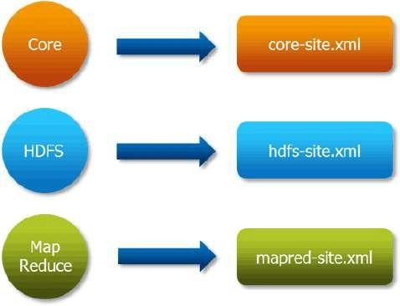
Configuring XML files

Slide 79
Hadoop Cluster Configuration Files
Configuration Filenames | Description of Log Files
Hadoop-env.sh | Environment variables that are used in the scripts to run Hadoop.
core-site.xml | Configuration settings for Hadoop Core such as I/O settings that are common to HDFS and MapReduce.
hdfs-site.xml | Configuration settings for HDFS daemons, the namenode, the secondary namenode and the data nodes.
mapred-site.xml | Configuration settings for MapReduce daemons; the job-tracker and thetask-trackers.
masters | A list of machines (one per line) that each run a secondary namenode.
slaves | A list of machines (one per line) that each run a datanode and a task-tracker.

Slide 80
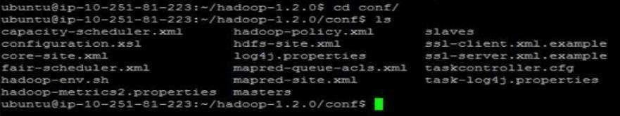
All these files are available under „conf‟ directory of Hadoop installation directory.
Here is a listing of these files in the File System:

